Slide 1
A BETTER HEALTH PLAN EXPERIENCE

Slide 2
Platform Upgrade| Agenda
Concierge
Telemedicine Platform
Electronic Features
ID Cards

Slide 3
Platform Upgrade |Concierge
Vitori Health Concierge phone number will be changing effective July 1, 2024 to:
(866) 661-2553
Concierge can assist with:
Benefit Questions
Billing Questions
Orientation to member portal
Claims
Pharmacy assistance
& more

Slide 4
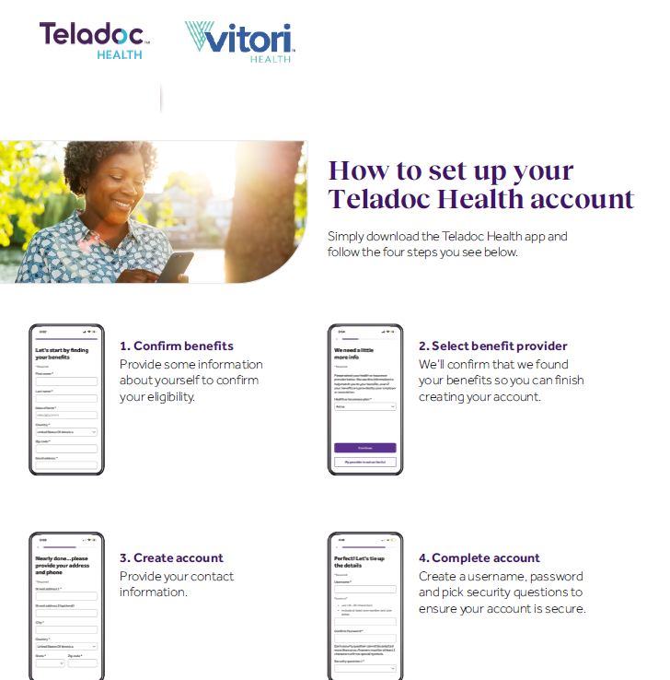
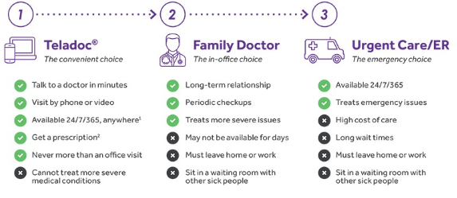
Platform Upgrade |Telemedicine
COPYRIGHT 2024 | VITORI HEALTH | ALL RIGHTS RESERVED

Slide 5
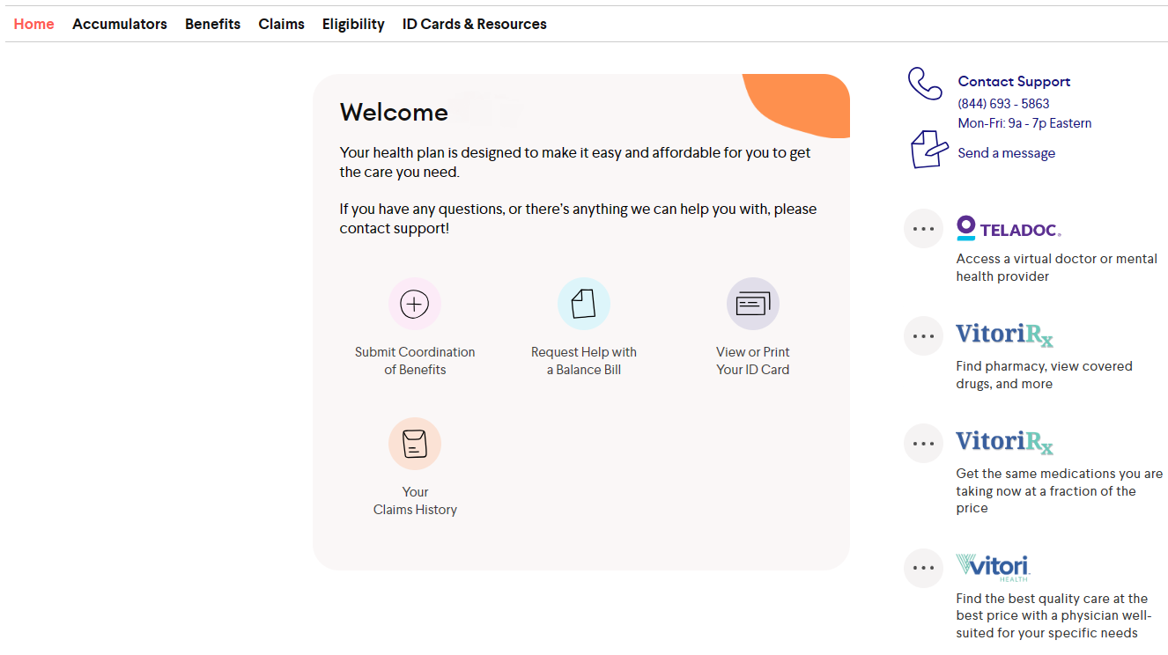
Platform Upgrade |Member Portal
Creating your account on the Vitori Health member portal is easy!
866-661-2553
Vitori Mobile App including the portal message feature will no longer be available effective July 1, 2024
Visit the New Member Portal at https://my.vitorihealth.com once you receive your updated Member ID in the Welcome Packet.
Explore your benefits
Take a few minutes to read more about your plan.
View Your Claims History or Request help with a Bill
View or Print your member ID card(s).
COPYRIGHT 2024 | VITORI HEALTH | ALL RIGHTS RESERVED

Slide 6
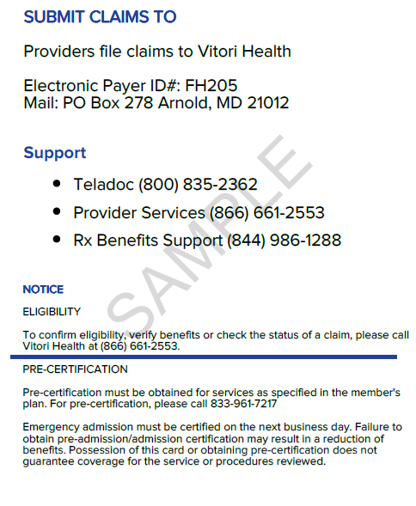
Platform Upgrade|Member ID Cards
New ID cards will be sent to all members prior to July 1, 2024
Changes to the ID cards:
Member ID
Group ID
Concierge #
Prime Network Logo
Claims Address
COPYRIGHT 2024 | VITORI HEALTH | ALL RIGHTS RESERVED

